Slide 1
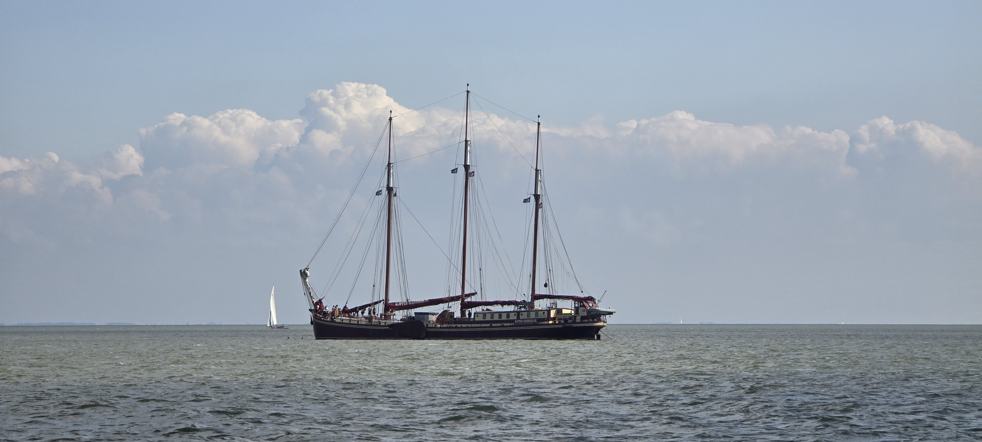
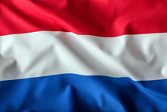
Netherlands Cruise discussions
11 April 2025

Slide 2
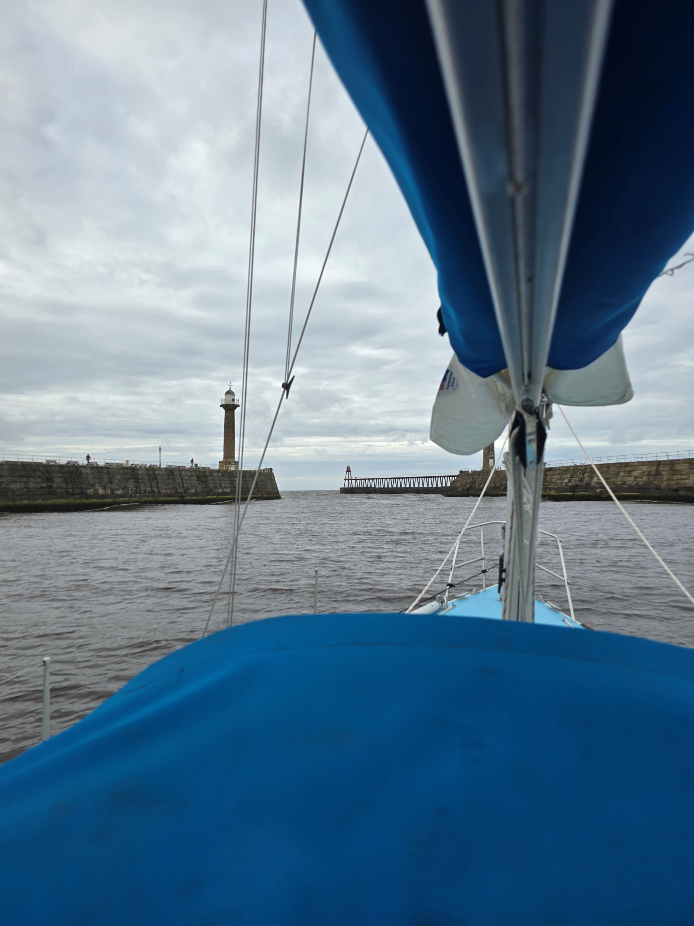
Netherlands Cruise Evening
The basics
Dates
Link with North Sea Race (NSR)
Other options to take part
Who’s going?
Taking your own boat
Fit for purpose? You and it?
Route options (inc NSR) – outbound & return
Legal & Customs requirements, boat, skipper, crew
Chartering
‘Own-Boat’, including De Toerzeilers connection
Other options?
Possible itineraries in the Netherlands
Sailing areas
Places to visit
Link-ups with De Toerzeilers?
Discussion

Slide 3
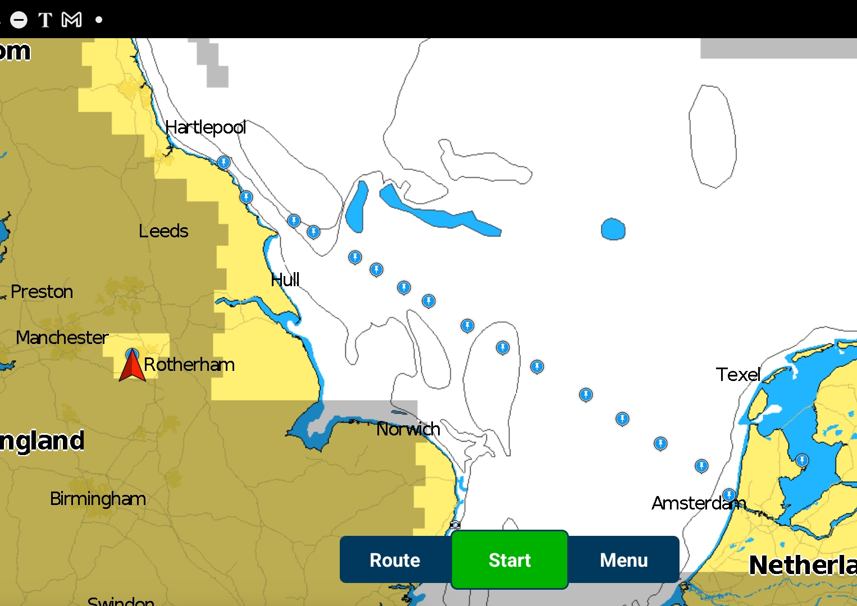
The basics
NSR starts Saturday 4 July from Scarborough, ends c. 36 – 48 hours later at IJmuden
Tuesday 8 July, NSR Gala Dinner at Hoorn
Approximately two weeks of cruising in the Netherlands anticipated
Three Whitby boats in NSR, so far
Interest for this cruise from Scarborough boats
Dave & Liz chartering in the Netherlands

Slide 4
Taking your own boat
Crossing the North Sea is a SERIOUS undertaking!
Natural hazards
Static hazards
Moving hazards
Exclusion zones & TSSs
Legislative compliance
This Photo by Unknown Author is licensed under CC BY

Slide 5
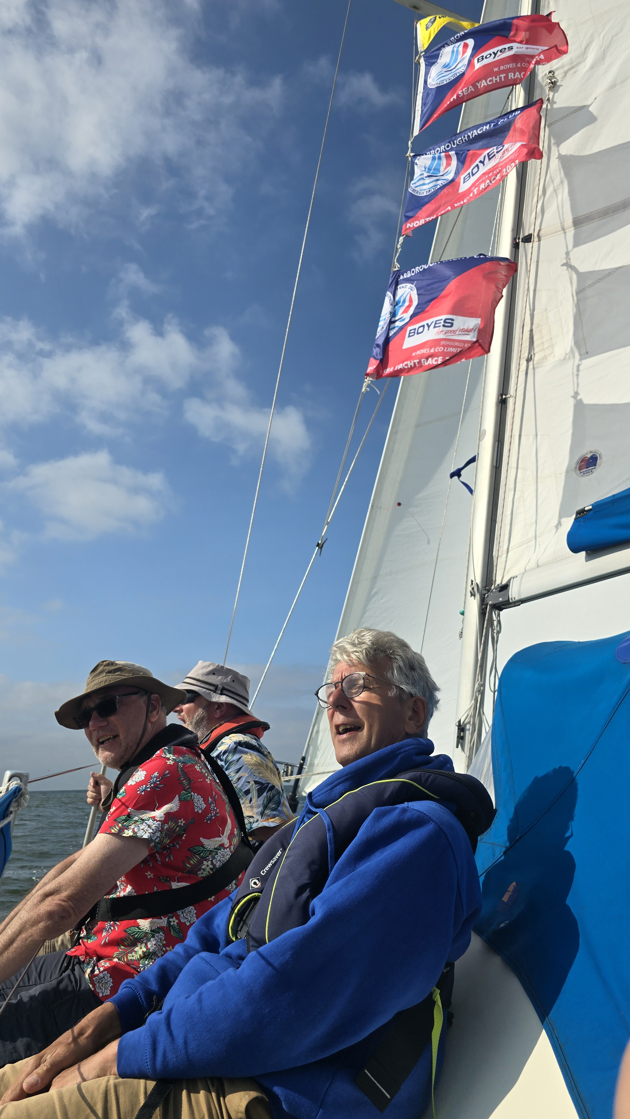
Taking your own boat, continued
Fit for purpose?
Boat & its equipment?
Skipper and crew skills, experience and temperament?
Practicalities
Navigation & tides https://d.docs.live.net/9ed657a691c5c09b/TRIO%20in%20the%20cloud/Whitby%20Yacht%20Club/RC%20Cruise/Netherlands%20Cruise%2025/3H%20After%20HW%20Harlingen.jpg
Watch system https://d.docs.live.net/9ed657a691c5c09b/TRIO%20in%20the%20cloud/Whitby%20Yacht%20Club/RC%20Cruise/Netherlands%20Cruise%2025/North%20Sea%20Race%20Tides%20and%20Watch%20Timings%202024.xlsx
Victualling & catering
Insurance

Slide 6
Own boat… Route options, there and back

Slide 7
Legal & Customs requirements
Crew manifest, required in and out-bound to Netherlands. https://english.marechaussee.nl/topics/reporting-requirements-for-commercial-and-recreational-vessels
Documents for UK vessels going to Europe, including getting an ICC. https://www.rya.org.uk/knowledge/abroad/paperwork .
Other useful information for UK craft going to Netherlands https://www.rya.org.uk/knowledge/abroad/country-specific-advice/netherlands

Slide 8
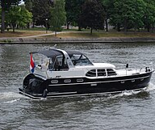
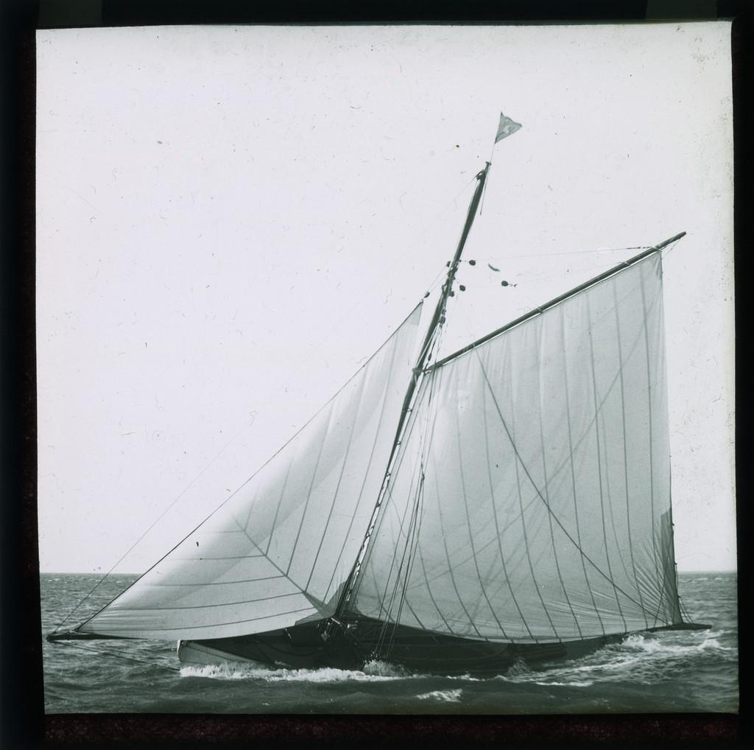
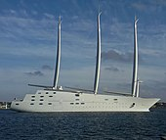
Chartering
https://www.ownship.nl/en/
Sailing Boat hire Netherlands - Sailboat Rentals - Rentals for a cheap price – Nautal
Yacht Charter – Sailboats, Catamarans & Motor Yachts | Pitter Yachting
This Photo by Unknown Author is licensed under CC BY-SA
This Photo by Unknown Author is licensed under CC BY-NC-ND
This Photo by Unknown Author is licensed under CC BY-SA

Slide 9
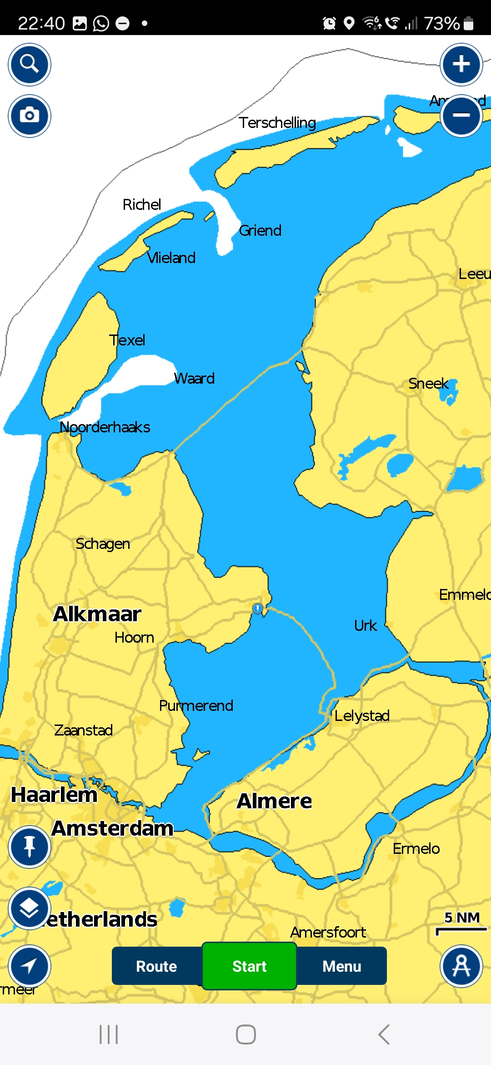
Itineraries in the Netherlands

Slide 10
Stand Mast Route
https://d.docs.live.net/9ed657a691c5c09b/TRIO%20in%20the%20cloud/Whitby%20Yacht%20Club/RC%20Cruise/Netherlands%20Cruise%2025/Standing%20Mast%20Guide%202025%20(digital).pdf

Slide 11
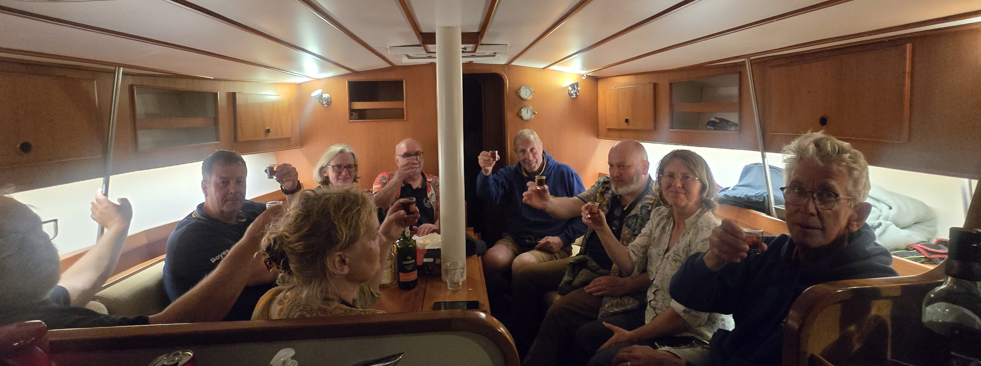
Discussion
Who’s interested?
Questions?
Next steps / further meetings, discussions and details?

